Slide 1
St. Louis Central Corridor West Building Permits
Quarter 1 Report: 2020

Slide 2
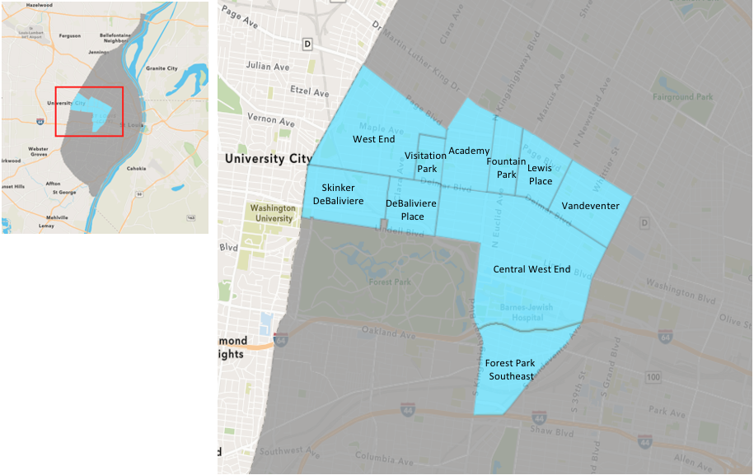
St. Louis Neighborhood Spatial Reference

Slide 3
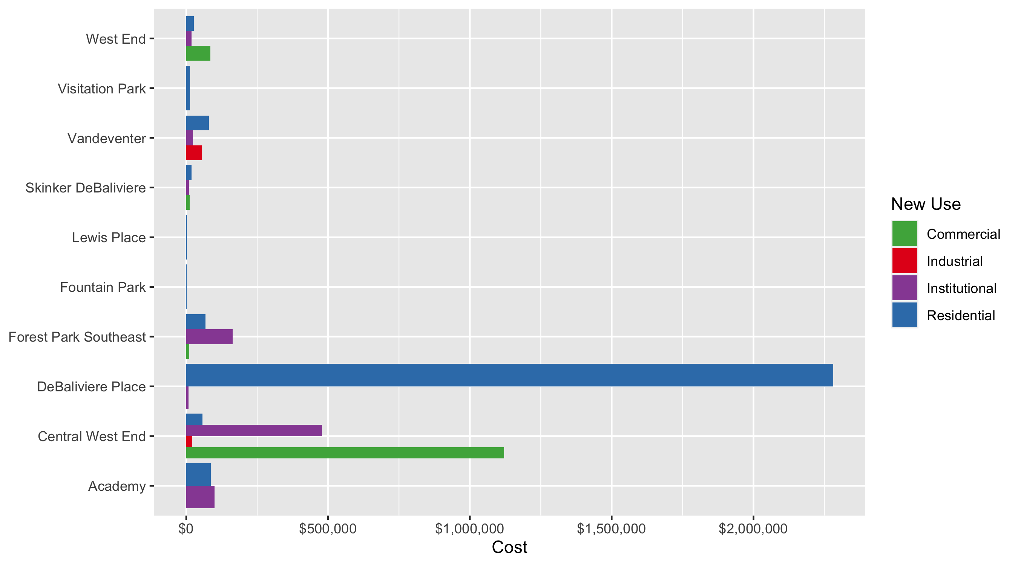
Neighborhood Summary: Average Building Permit Cost

Slide 4
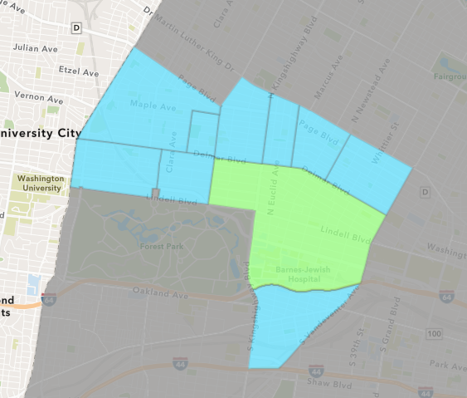
Central West End
Quarter 1 , 2020 Neighborhood Cost Breakdown
Mean: $358,115
Median: $21,676
Range: $250 - $16,000,000

Slide 5
Central West End: Summary Notes
109 building permits in Quarter 1, 2020
-11.38% change compared to Quarter 1, 2019 (123 total building permits)
$358,115: Average building permit cost in Quarter 1, 2020
87.47% change compared to Quarter 1, 2019 ($191,028)

Slide 6
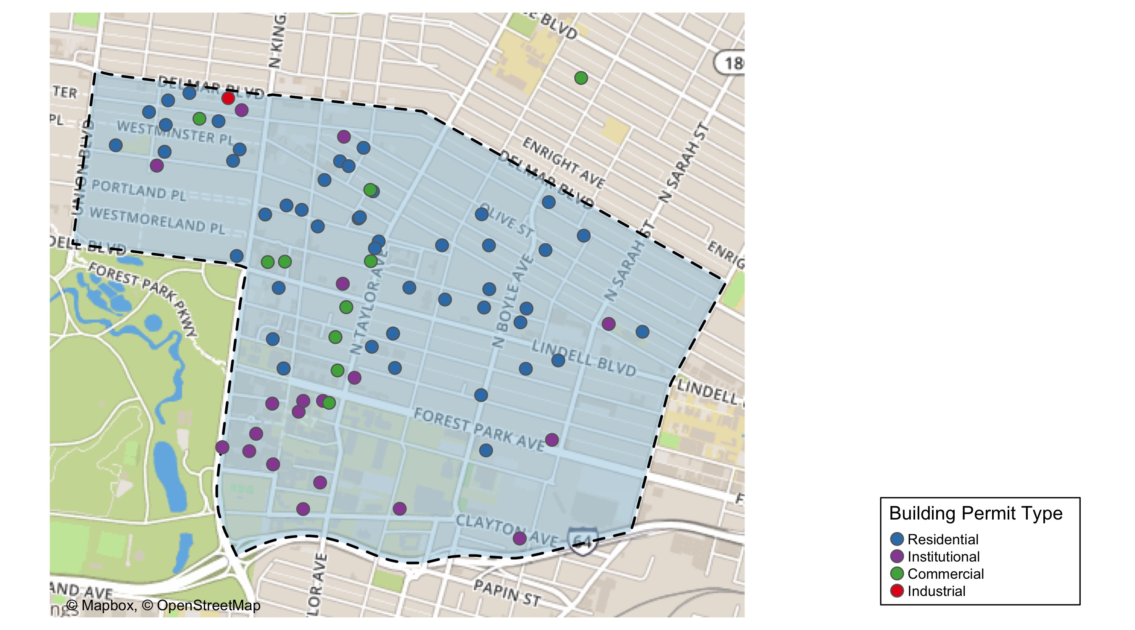
Central West End

Slide 7
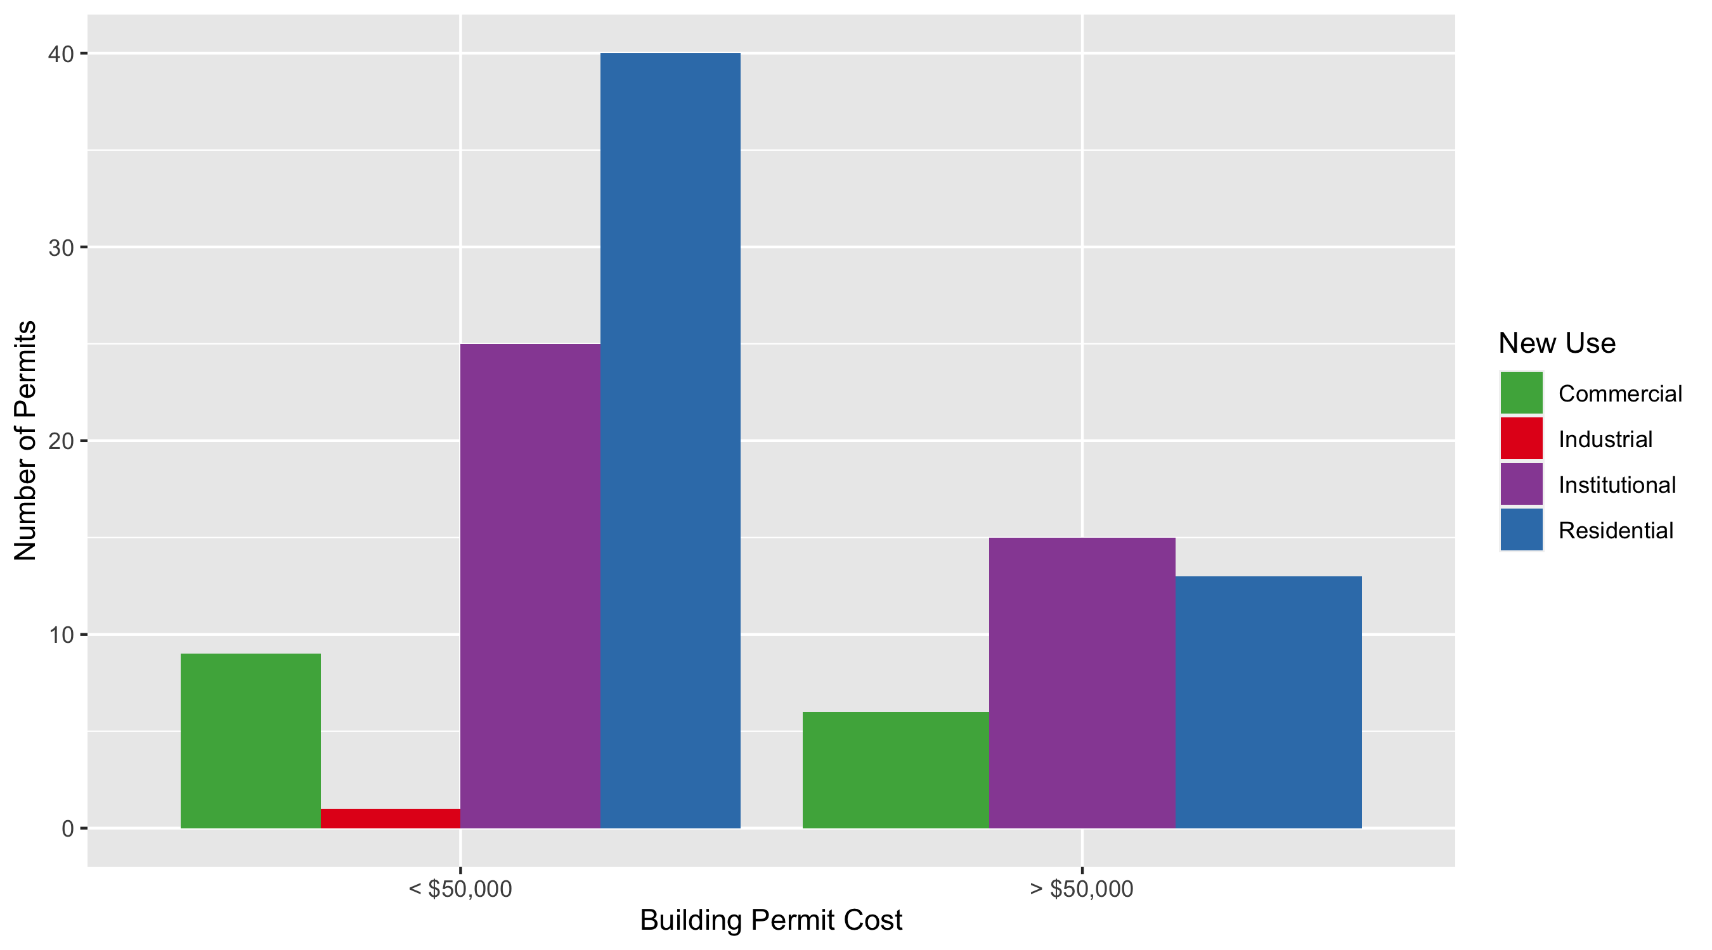
Central West End Permit Use Breakdown

Slide 8
Central West End
Quarter 1, 2020 | Quarter 1, 2020 | Quarter 1, 2020 | Quarter 1, 2020
Permit Use | Average Cost | # of Permits | Total Value of Permits
Commercial | $1,120,197 | 15 | $16,802,948
Industrial | $21,676 | 1 | $21,676
Institutional | $478,568 | 40 | $19,142,737
Residential | $57,871 | 53 | $3,067,153
Quarter 1 2019 | Quarter 1 2019 | Quarter 1 2019 | Quarter 1 2019
Permit Use | Average Cost | # of Permits | Total Value of Permits
Commercial | $104,225 | 24 | $2,501,401
Industrial | $0 | 0 | $0
Institutional | $357,757 | 54 | $19,318,874
Residential | $37,247 | 45 | $1,676,124

Slide 9
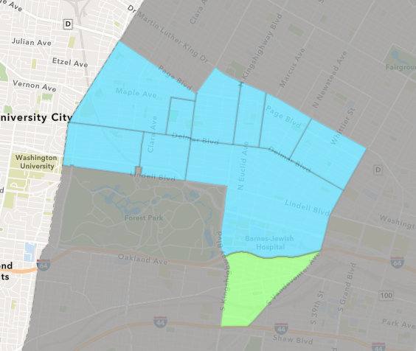
Forest Park Southeast
Quarter 1 , 2020 Neighborhood Cost Breakdown
Mean: $47,406
Median: $8,400
Range: $50 - $264,094

Slide 10
Forest Park Southeast: Summary Notes
20 building permits in Quarter 1, 2020
-61.54% change compared to Quarter 1, 2019 (52 total building permits)
$47,406: Average building permit cost in Quarter 1, 2020
-75.04% change compared to Quarter 1, 2019 ($189,950)

Slide 11
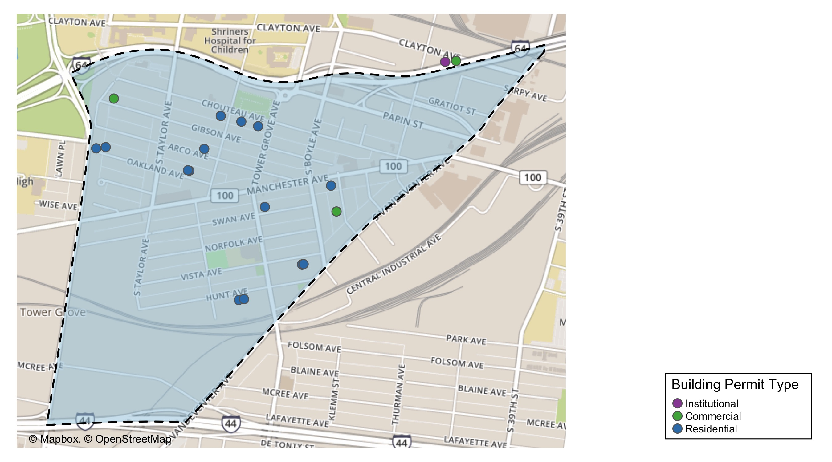
Forest Park Southeast

Slide 12
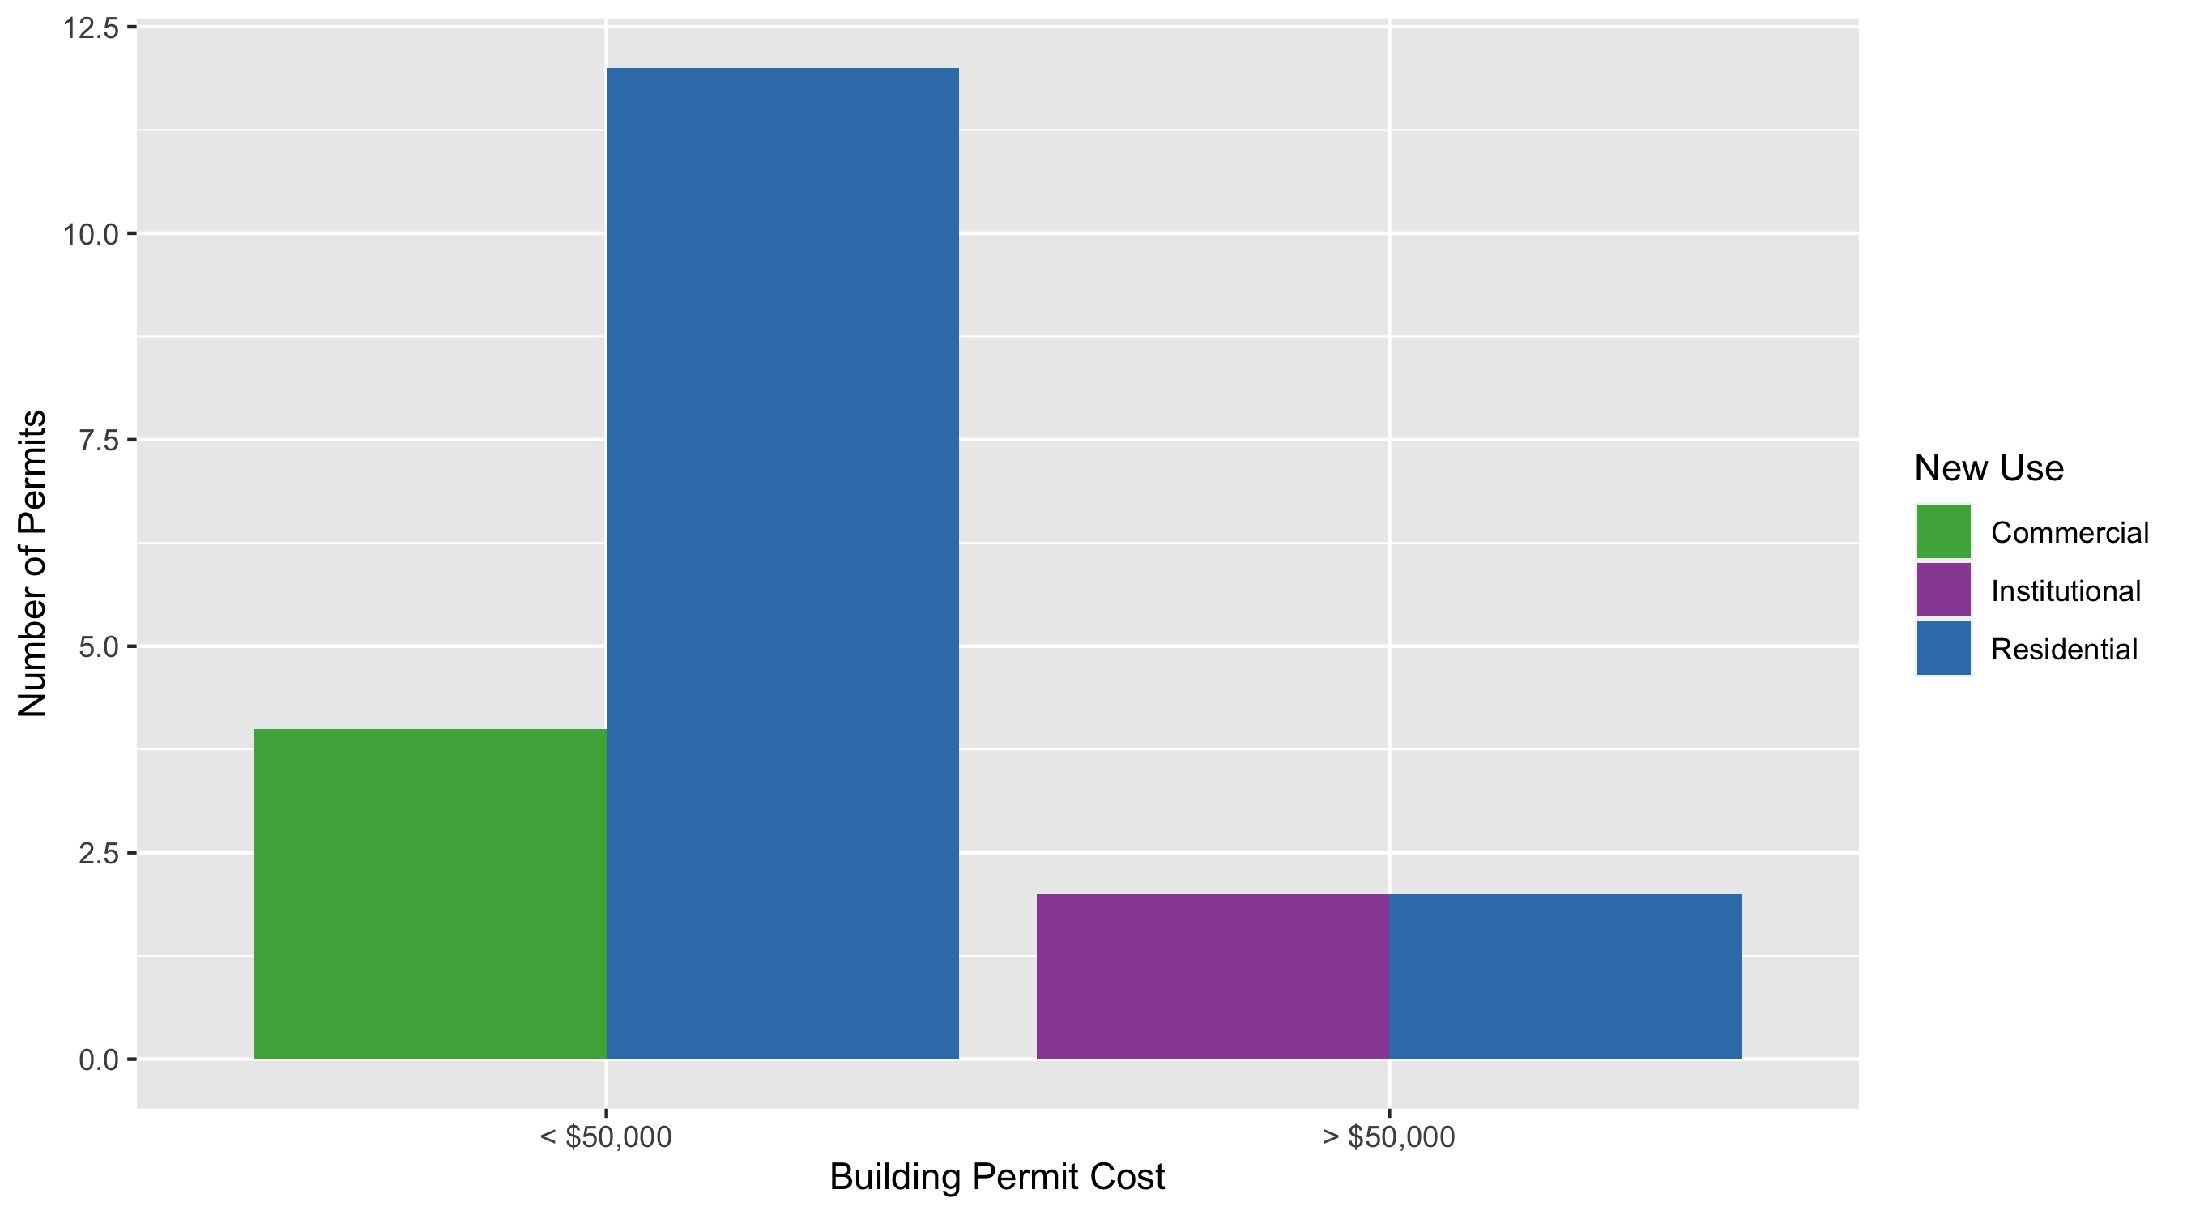
Forest Park Southeast Permit Use Breakdown

Slide 13
Forest Park Southeast
Quarter 1, 2020 | Quarter 1, 2020 | Quarter 1, 2020 | Quarter 1, 2020
Permit Use | Average Cost | # of Permits | Total Value of Permits
Commercial | $10,225 | 4 | $40,900
Industrial | $0 | 0 | $0
Institutional | $164,120 | 2 | $328,239
Residential | $41,356 | 14 | $578,990
Quarter 1 2019 | Quarter 1 2019 | Quarter 1 2019 | Quarter 1 2019
Permit Use | Average Cost | # of Permits | Total Value of Permits
Commercial | $154,888 | 12 | $1,858,651
Industrial | $13,500 | 2 | $27,000
Institutional | $770,986 | 5 | $3,854,929
Residential | $125,358 | 33 | $4,136,805

Slide 14
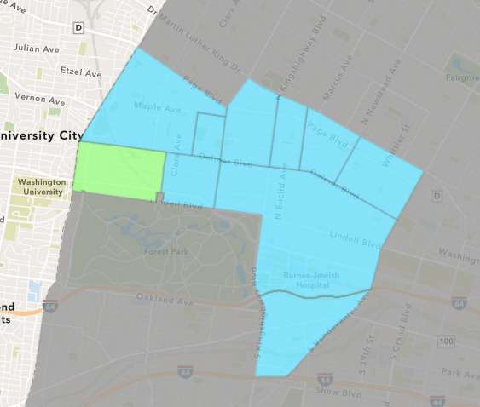
Skinker DeBaliviere
Quarter 1 , 2020 Neighborhood Cost Breakdown
Mean: $17,478
Median: $8,450
Range: $150 - $150,000

Slide 15
Skinker DeBaliviere: Summary Notes
35 building permits in Quarter 1, 2020
105.88% change compared to Quarter 1, 2019 (17 total building permits)
$17,478: Average building permit cost in Quarter 1, 2020
-6.30% change compared to Quarter 1, 2019 ($18,653)

Slide 16
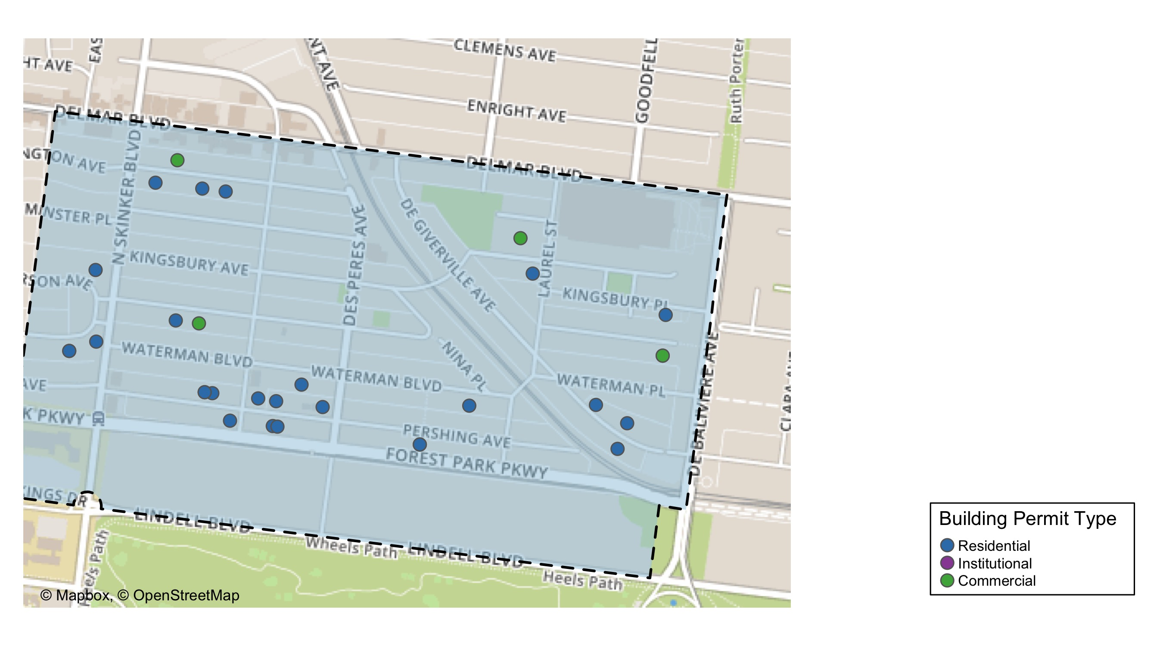
Skinker DeBaliviere

Slide 17
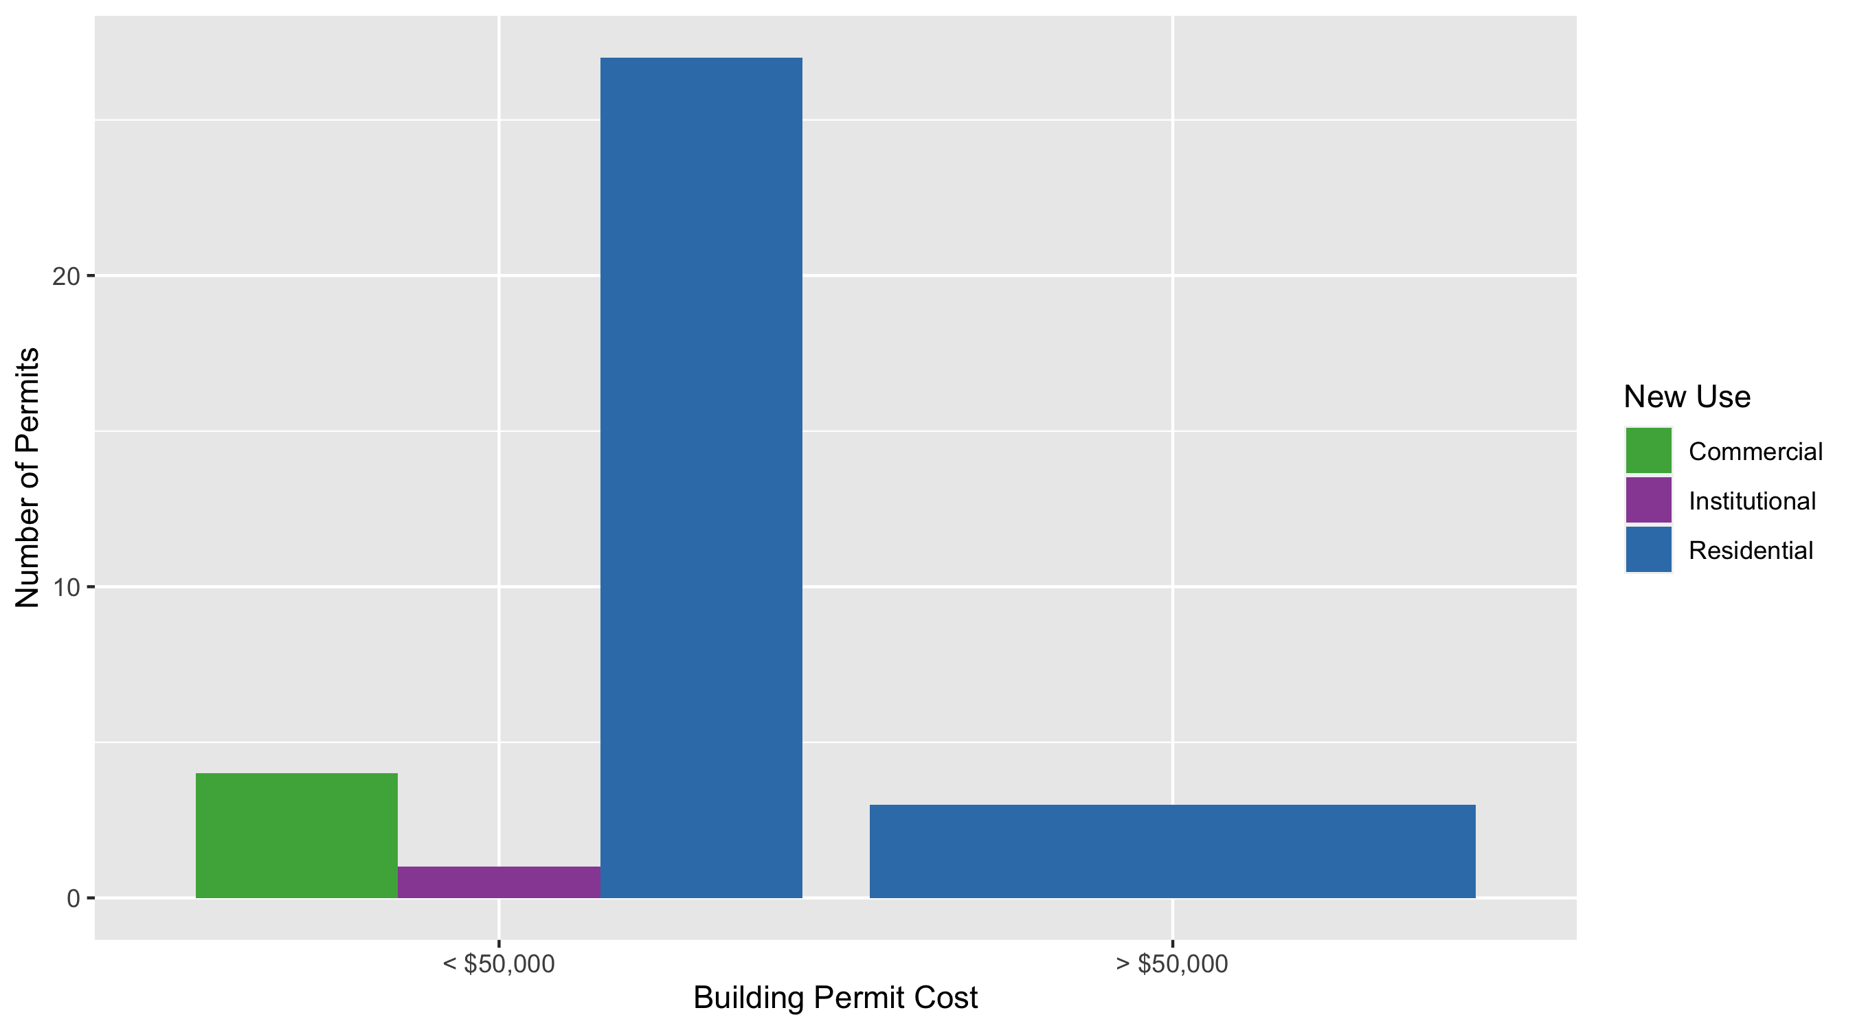
Skinker DeBaliviere Permit Use Breakdown

Slide 18
Skinker DeBaliviere
Quarter 1, 2020 | Quarter 1, 2020 | Quarter 1, 2020 | Quarter 1, 2020
Permit Use | Average Cost | # of Permits | Total Value of Permits
Commercial | $12,219 | 4 | $48,876
Industrial | $0 | 0 | $0
Institutional | $10,000 | 1 | $10,000
Residential | $18,429 | 30 | $552,867
Quarter 1 2019 | Quarter 1 2019 | Quarter 1 2019 | Quarter 1 2019
Permit Use | Average Cost | # of Permits | Total Value of Permits
Commercial | $0 | 0 | $0
Industrial | $0 | 0 | $0
Institutional | $70,000 | 1 | $70,000
Residential | $15,444 | 16 | $247,104

Slide 19
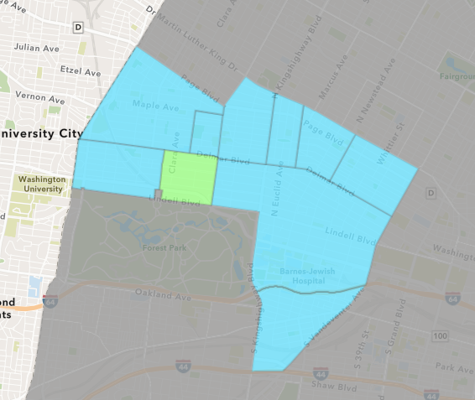
DeBaliviere Place
Quarter 1 , 2020 Neighborhood Cost Breakdown
Mean: $2,028,178
Median: $22,000
Range: $2,500 - $18,000,000

Slide 20
DeBaliviere Place: Summary Notes
9 building permits in Quarter 1, 2020
-30.77% change compared to Quarter 1, 2019 (13 total building permits)
$2,028,178: Average building permit cost in Quarter 1, 2020
5989.70% change compared to Quarter 1, 2019 ($33,305)

Slide 21
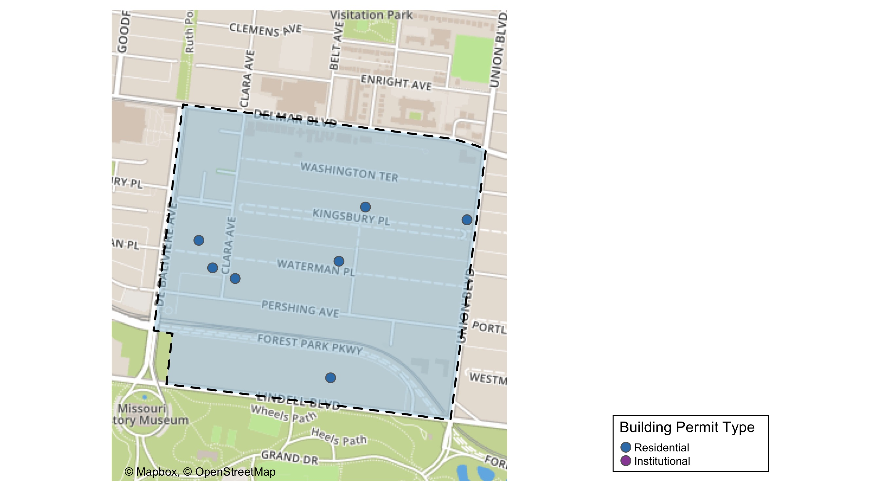
DeBaliviere Place

Slide 22
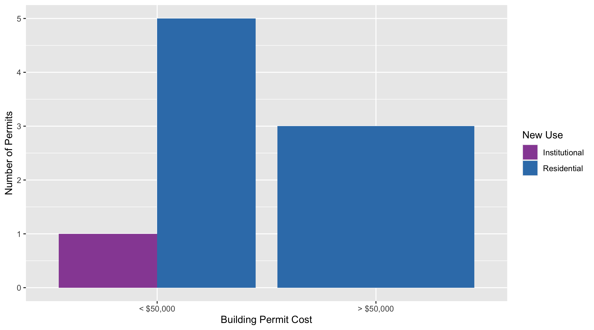
DeBaliviere Place Permit Use Breakdown

Slide 23
DeBaliviere Place
Quarter 1, 2020 | Quarter 1, 2020 | Quarter 1, 2020 | Quarter 1, 2020
Permit Use | Average Cost | # of Permits | Total Value of Permits
Commercial | $0 | 0 | $0
Industrial | $0 | 0 | $0
Institutional | $8,000 | 1 | $8,000
Residential | $2,280,701 | 8 | $18,245,606
Quarter 1 2019 | Quarter 1 2019 | Quarter 1 2019 | Quarter 1 2019
Permit Use | Average Cost | # of Permits | Total Value of Permits
Commercial | $10,000 | 1 | $10,000
Industrial | $0 | 0 | $0
Institutional | $0 | 0 | $0
Residential | $35,247 | 12 | $422,966

Slide 24
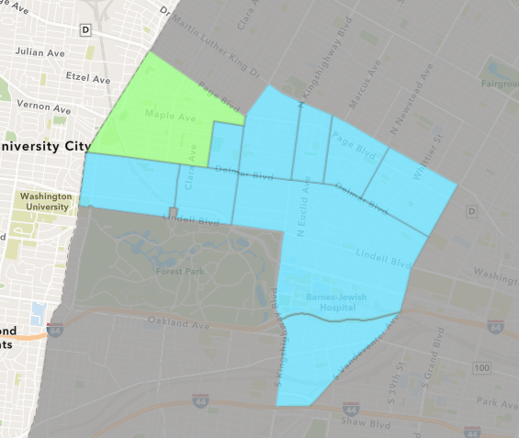
West End
Quarter 1 , 2020 Neighborhood Cost Breakdown
Mean: $38,904
Median: $9,350
Range: $1,000 - $375,000

Slide 25
West End: Summary Notes
23 building permits in Quarter 1, 2020
155.56% change compared to Quarter 1, 2019 (9 total building permits)
$38,904: Average building permit cost in Quarter 1, 2020
-83.35% change compared to Quarter 1, 2019 ($233,633)

Slide 26
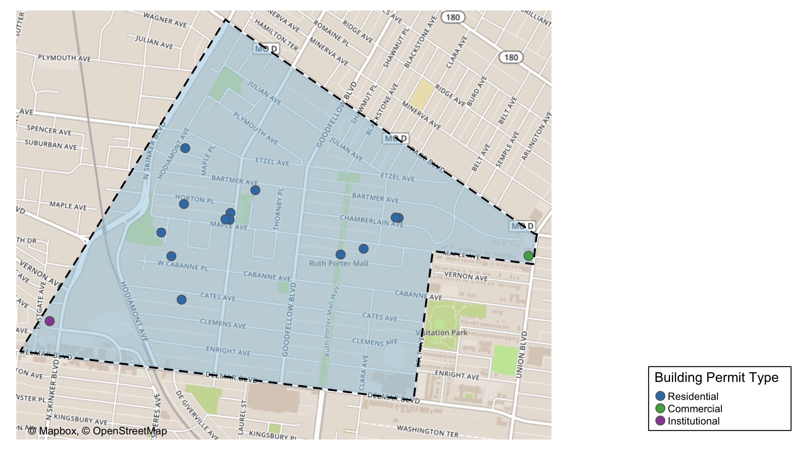
West End

Slide 27
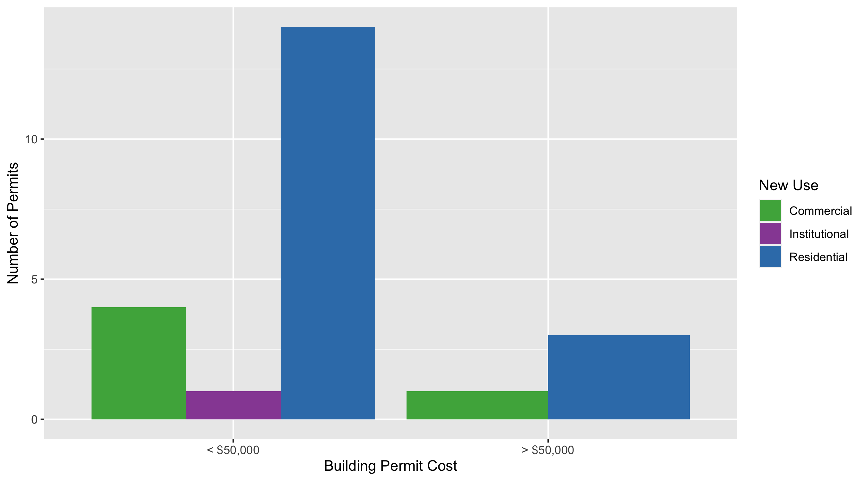
West End Permit Use Breakdown

Slide 28
West End
Quarter 1, 2020 | Quarter 1, 2020 | Quarter 1, 2020 | Quarter 1, 2020
Permit Use | Average Cost | # of Permits | Total Value of Permits
Commercial | $85,510 | 5 | $427,550
Industrial | $0 | 0 | $0
Institutional | $18,000 | 1 | $18,000
Residential | $26,426 | 17 | $449,246
Quarter 1 2019 | Quarter 1 2019 | Quarter 1 2019 | Quarter 1 2019
Permit Use | Average Cost | # of Permits | Total Value of Permits
Commercial | $279,883 | 6 | $1,679,300
Industrial | $0 | 0 | $0
Institutional | $383,400 | 1 | $383,400
Residential | $20,000 | 2 | $40,000

Slide 29
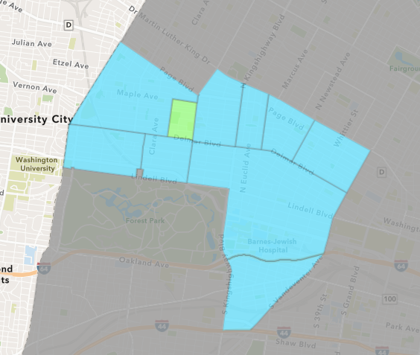
Visitation Park
Quarter 1 , 2020 Neighborhood Cost Breakdown
Mean: $14,000
Median: $14,000
Range: $14,000 - $14,000

Slide 30
Visitation Park: Summary Notes
1 building permits in Quarter 1, 2020
Infinite change compared to Quarter 1, 2019 (0 total building permits)
$14,000: Average building permit cost in Quarter 1, 2020
Infinite change compared to Quarter 1, 2019 ($0)

Slide 31
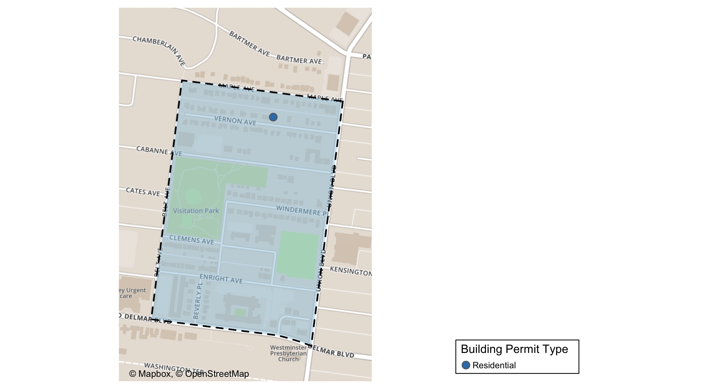
Visitation Park

Slide 32
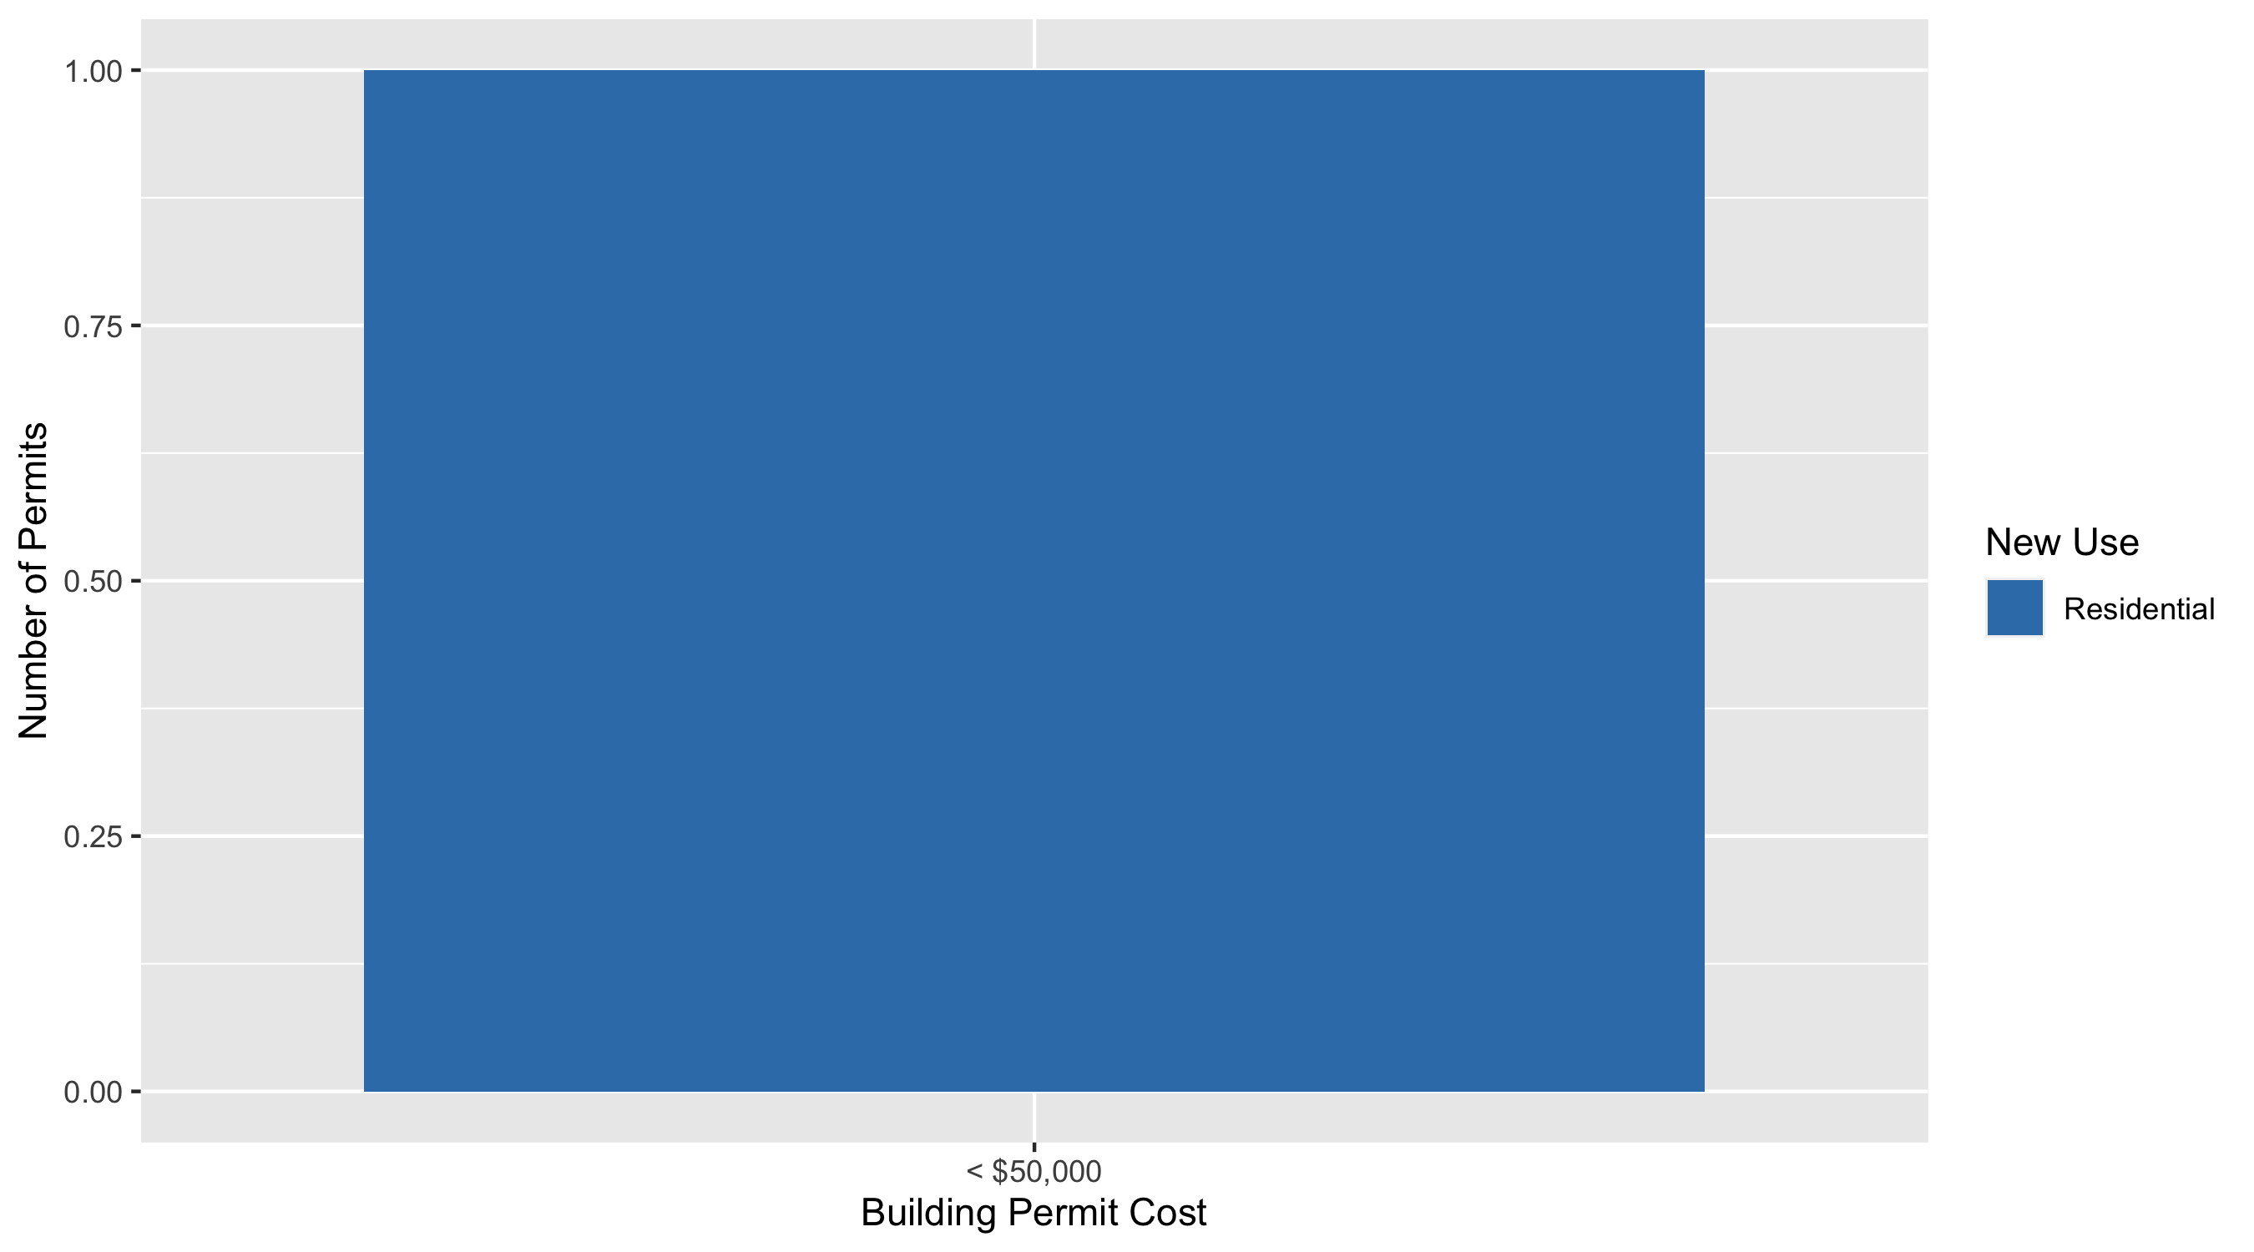
Visitation Park Permit Use Breakdown

Slide 33
Visitation Park Permit Breakdown
2020 | 2020 | 2020 | 2020
Permit Use | Average Cost | # of Permits | Total Value of Permits
Commercial | 0 | 0 | 0
Industrial | 0 | 0 | 0
Institutional | 0 | 0 | 0
Residential | 14000 | 1 | 14000

Slide 34
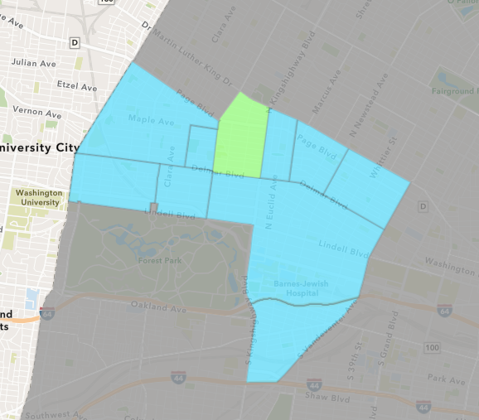
Academy
Quarter 1 , 2020 Neighborhood Cost Breakdown
Mean: $87,495
Median: $77,500
Range: $1,500 - $200,000

Slide 35
Academy: Summary Notes
10 building permits in Quarter 1, 2020
42.86% change compared to Quarter 1, 2019 (7 total building permits)
$87,495: Average building permit cost in Quarter 1, 2020
12.03% change compared to Quarter 1, 2019 ($78,101)

Slide 36
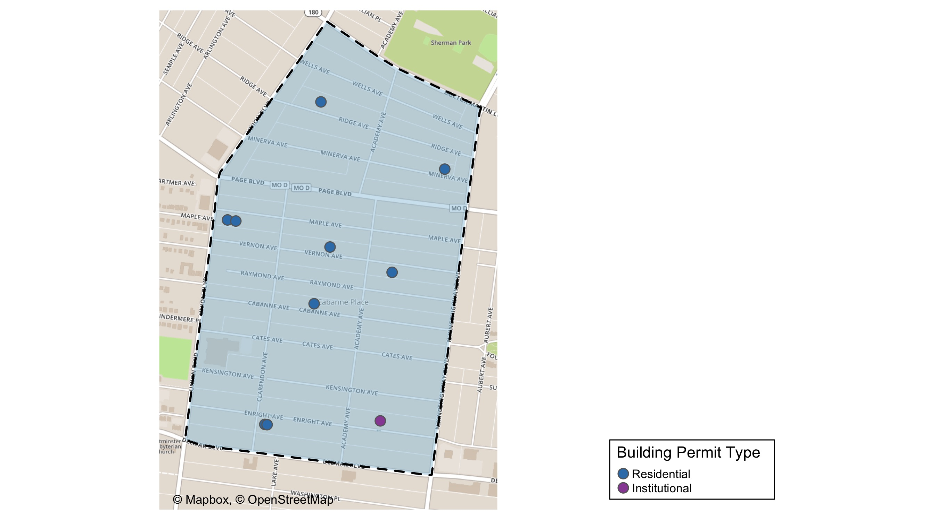
Academy

Slide 37
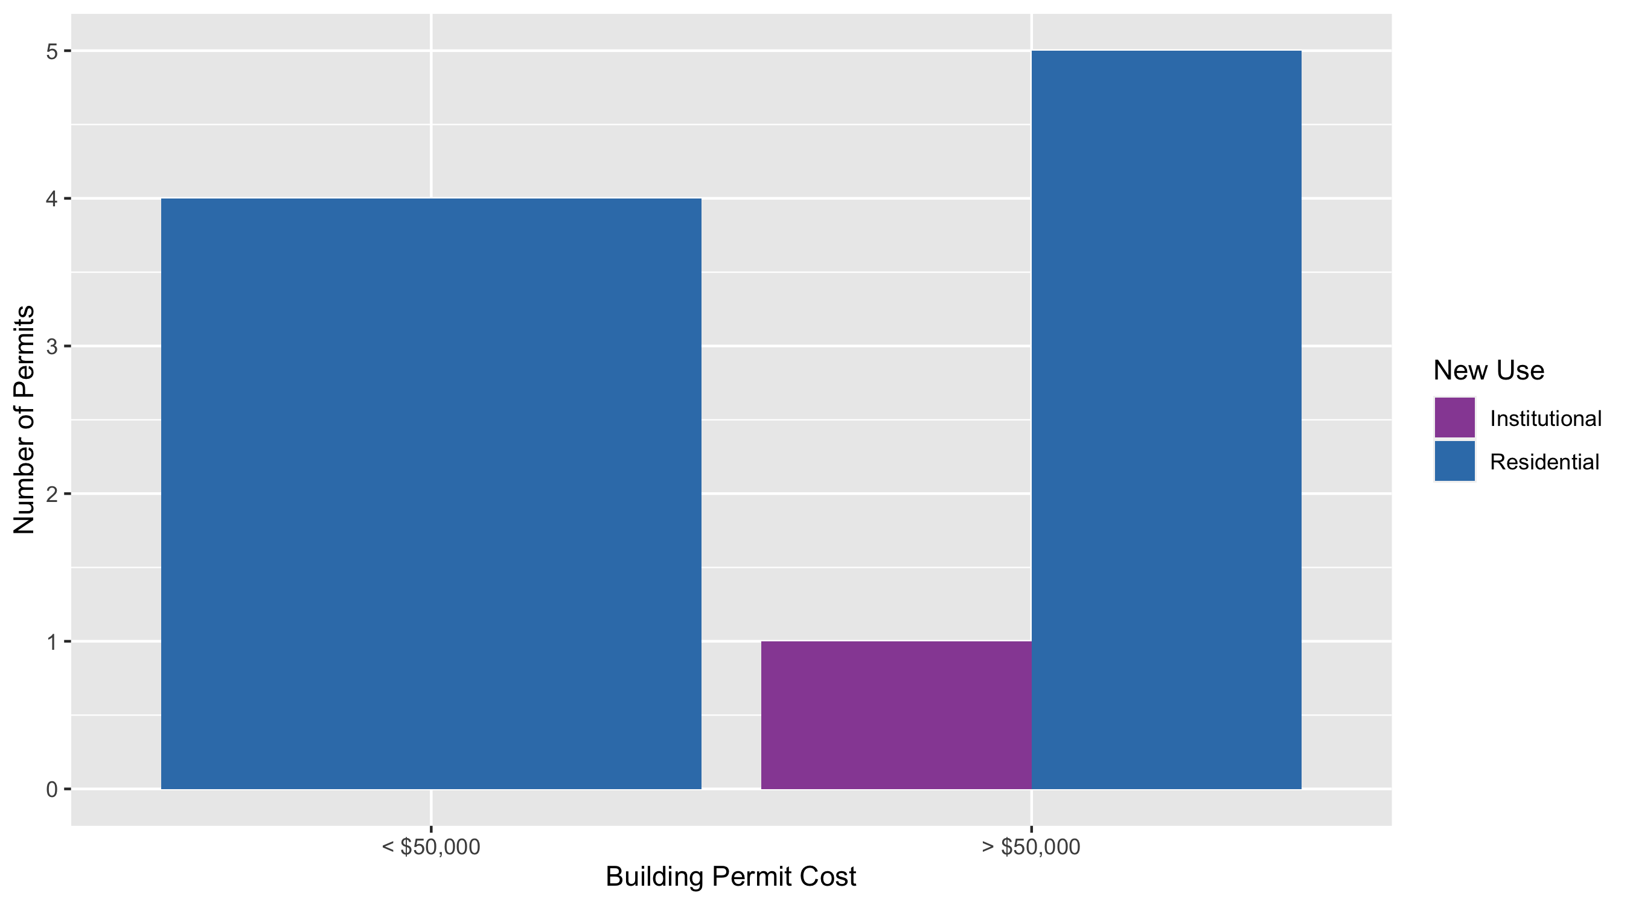
Academy Permit Use Breakdown

Slide 38
Academy
Quarter 1, 2020 | Quarter 1, 2020 | Quarter 1, 2020 | Quarter 1, 2020
Permit Use | Average Cost | # of Permits | Total Value of Permits
Commercial | $0 | 0 | $0
Industrial | $0 | 0 | $0
Institutional | $100,000 | 1 | $100,000
Residential | $86,106 | 9 | $774,950
Quarter 1 2019 | Quarter 1 2019 | Quarter 1 2019 | Quarter 1 2019
Permit Use | Average Cost | # of Permits | Total Value of Permits
Commercial | $0 | 0 | $0
Industrial | $0 | 0 | $0
Institutional | $0 | 0 | $0
Residential | $78,101 | 7 | $546,705

Slide 39
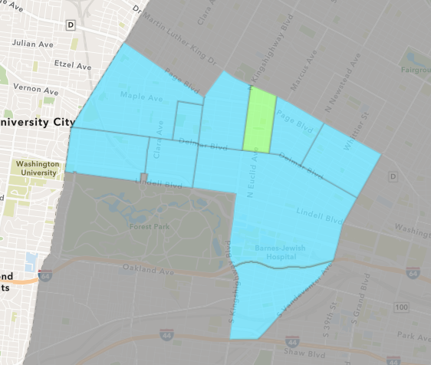
Fountain Park
Quarter 1 , 2020 Neighborhood Cost Breakdown
Mean: $2,000
Median: $2,000
Range: $2,000 - $2,000

Slide 40
Fountain Park: Summary Notes
1 building permits in Quarter 1, 2020
0.00% change compared to Quarter 1, 2019 (1 total building permits)
$2,000: Average building permit cost in Quarter 1, 2020
300.00% change compared to Quarter 1, 2019 ($500)

Slide 41
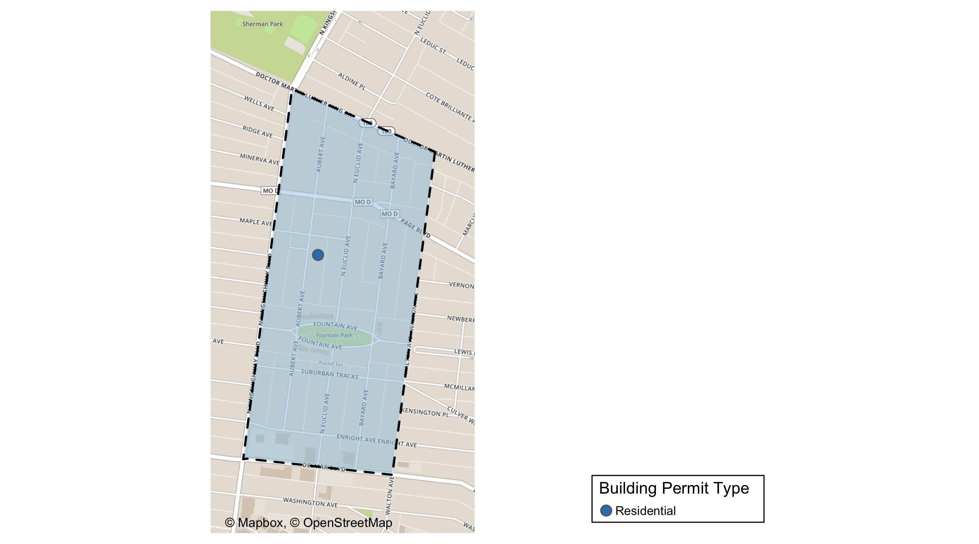
Fountain Park

Slide 42
Fountain Park Permit Use Breakdown

Slide 43
Fountain Park
Quarter 1, 2020 | Quarter 1, 2020 | Quarter 1, 2020 | Quarter 1, 2020
Permit Use | Average Cost | # of Permits | Total Value of Permits
Commercial | $0 | 0 | $0
Industrial | $0 | 0 | $0
Institutional | $0 | 0 | $0
Residential | $2,000 | 1 | $2,000
Quarter 1 2019 | Quarter 1 2019 | Quarter 1 2019 | Quarter 1 2019
Permit Use | Average Cost | # of Permits | Total Value of Permits
Commercial | $0 | 0 | $0
Industrial | $0 | 0 | $0
Institutional | $0 | 0 | $0
Residential | $500 | 1 | $500

Slide 44
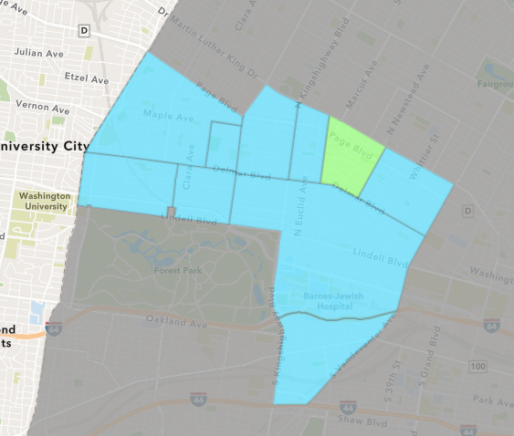
Lewis Place
Quarter 1 , 2020 Neighborhood Cost Breakdown
Mean: $2,500
Median: $2,500
Range: $2,500 - $2,500

Slide 45
Lewis Place: Summary Notes
1 building permits in Quarter 1, 2020
-80.00% change compared to Quarter 1, 2019 (5 total building permits)
$2,500: Average building permit cost in Quarter 1, 2020
-52.11% change compared to Quarter 1, 2019 ($5,220)

Slide 46
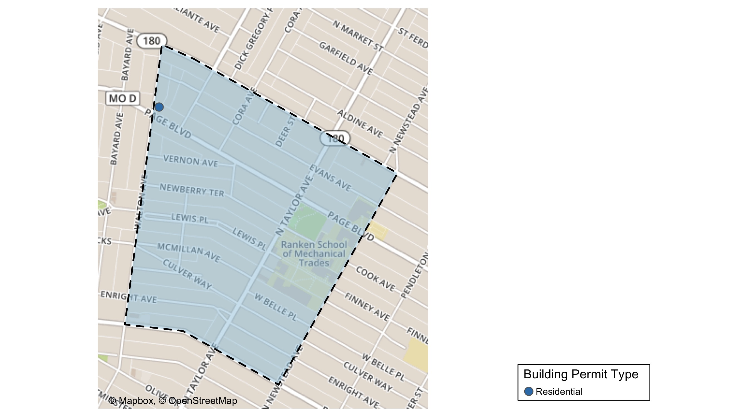
Lewis Place

Slide 47
Lewis Place Permit Use Breakdown

Slide 48
Lewis Place
Quarter 1, 2020 | Quarter 1, 2020 | Quarter 1, 2020 | Quarter 1, 2020
Permit Use | Average Cost | # of Permits | Total Value of Permits
Commercial | $0 | 0 | $0
Industrial | $0 | 0 | $0
Institutional | $0 | 0 | $0
Residential | $2,500 | 1 | $2,500
Quarter 1 2019 | Quarter 1 2019 | Quarter 1 2019 | Quarter 1 2019
Permit Use | Average Cost | # of Permits | Total Value of Permits
Commercial | $0 | 0 | $0
Industrial | $0 | 0 | $0
Institutional | $0 | 0 | $0
Residential | $5,220 | 5 | $26,100

Slide 49
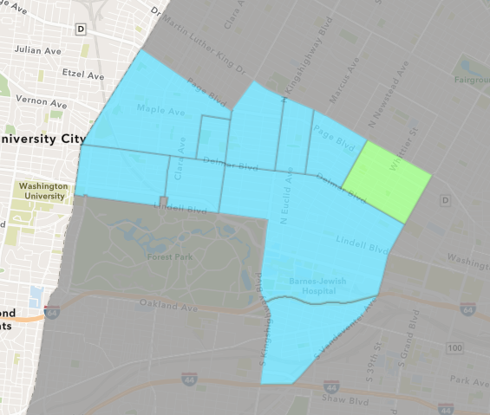
Vandeventer
Quarter 1 , 2020 Neighborhood Cost Breakdown
Mean: $29,126
Median: $23,646
Range: $8,731 - $55,000

Slide 50
Vandeventer: Summary Notes
3 building permits in Quarter 1, 2020
-62.50% change compared to Quarter 1, 2019 (8 total building permits)
$29,126: Average building permit cost in Quarter 1, 2020
-91.80% change compared to Quarter 1, 2019 ($355,241)

Slide 51
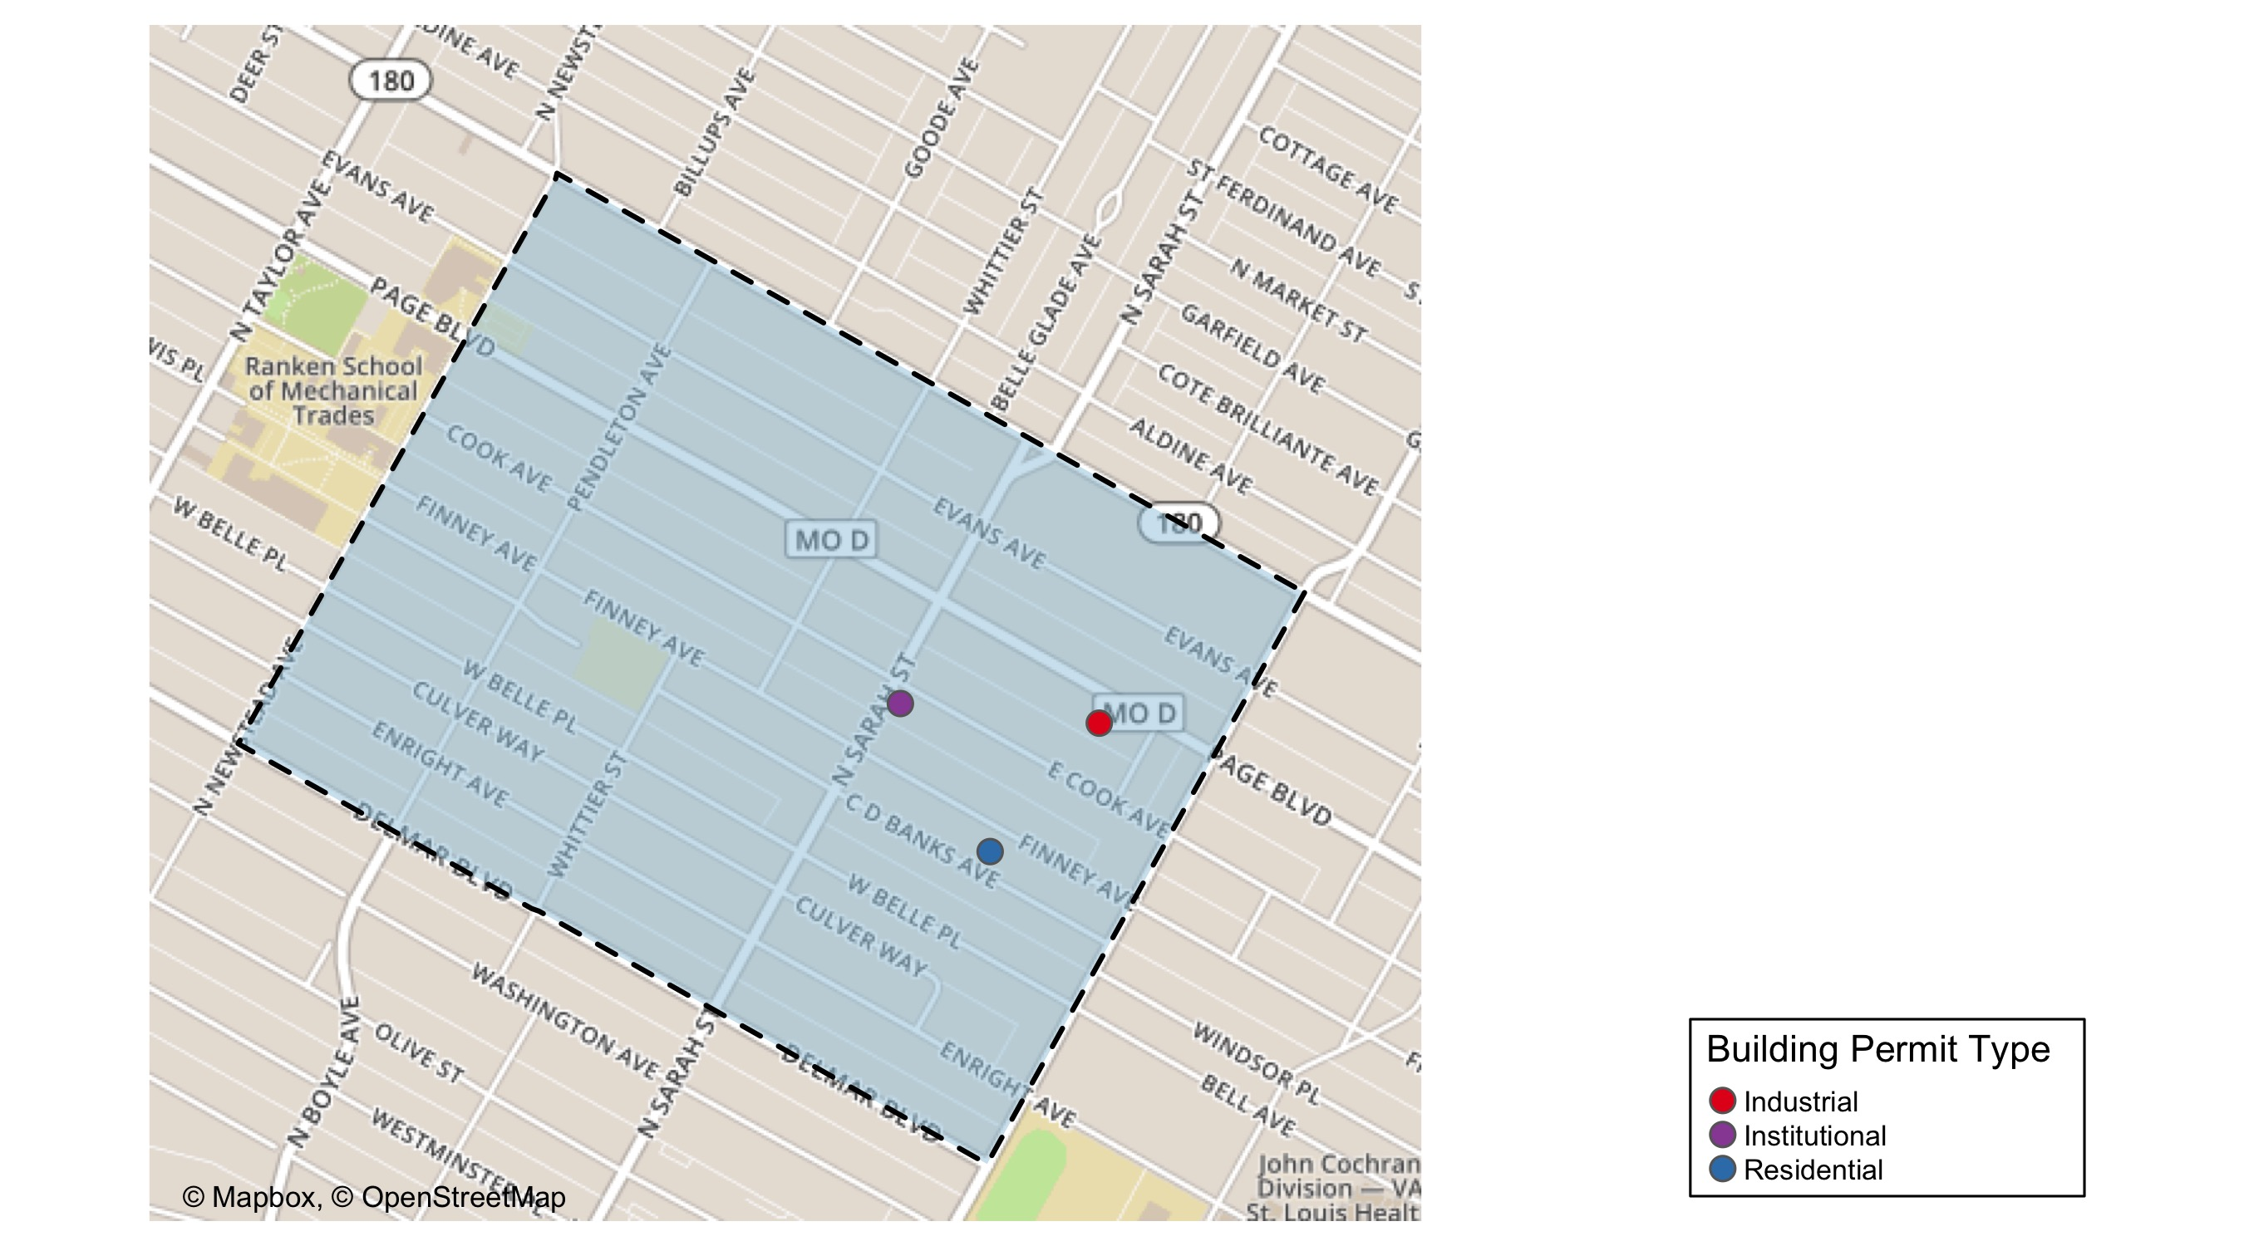
Vandeventer

Slide 52
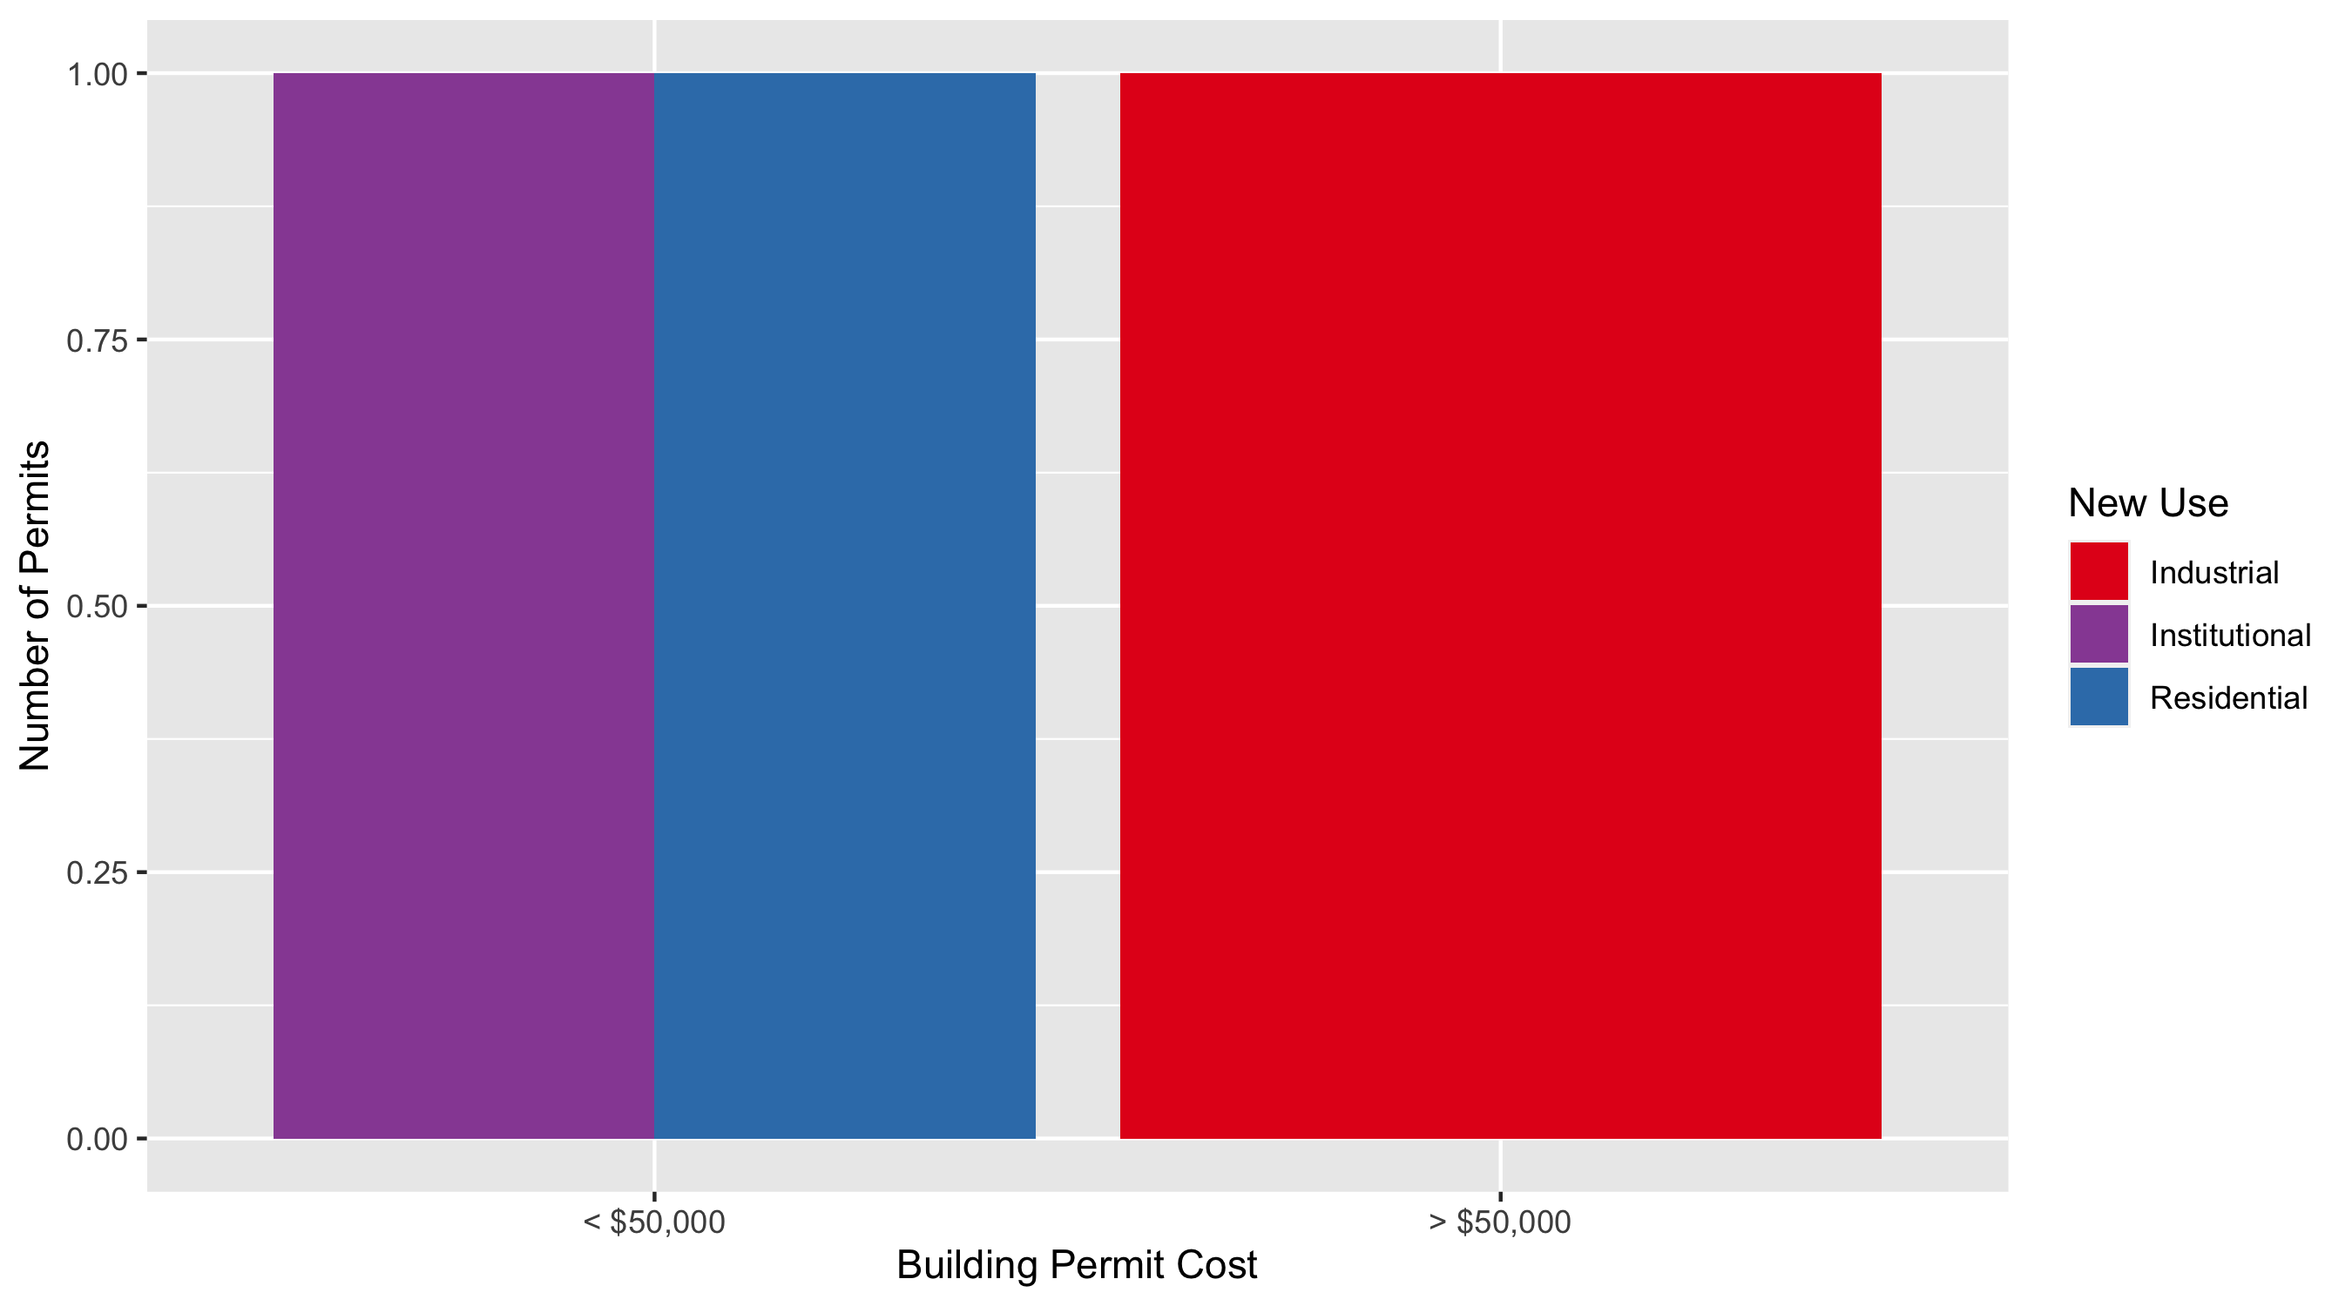
Vandeventer Permit Use Breakdown

Slide 53
Vandeventer
Quarter 1, 2020 | Quarter 1, 2020 | Quarter 1, 2020 | Quarter 1, 2020
Permit Use | Average Cost | # of Permits | Total Value of Permits
Commercial | $0 | 0 | $0
Industrial | $55,000 | 1 | $55,000
Institutional | $23,646 | 1 | $23,646
Residential | $8,731 | 1 | $8,731
Quarter 1 2019 | Quarter 1 2019 | Quarter 1 2019 | Quarter 1 2019
Permit Use | Average Cost | # of Permits | Total Value of Permits
Commercial | $2,746,645 | 1 | $2,746,645
Industrial | $0 | 0 | $0
Institutional | $64,000 | 1 | $64,000
Residential | $5,214 | 6 | $31,285

Slide 54
Additional Notes
Data retreived from https://www.stlouis-mo.gov/data/
Building permits with a cost of $0 were dropped
Building permits that were cancelled were dropped
Infinite change indicates 0 permits in the current or previous time period/comparison month so there was a overall increase or decrease

